Slide 1

^{Tutorial |} ASV-isolate matching SAGE II | 28.03.23 | Daniel Garrido Sanz & Julian Garneau

Slide 2
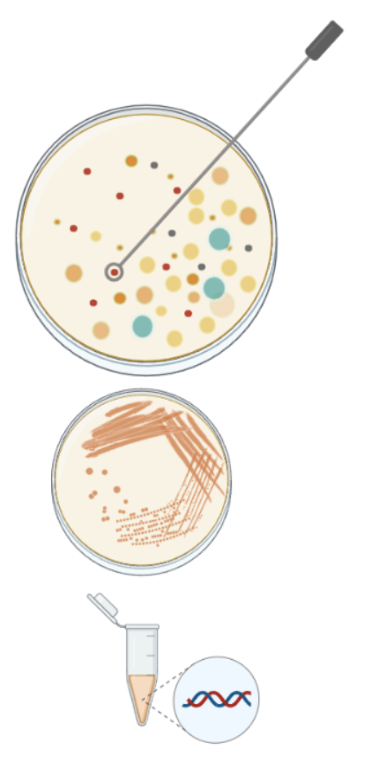
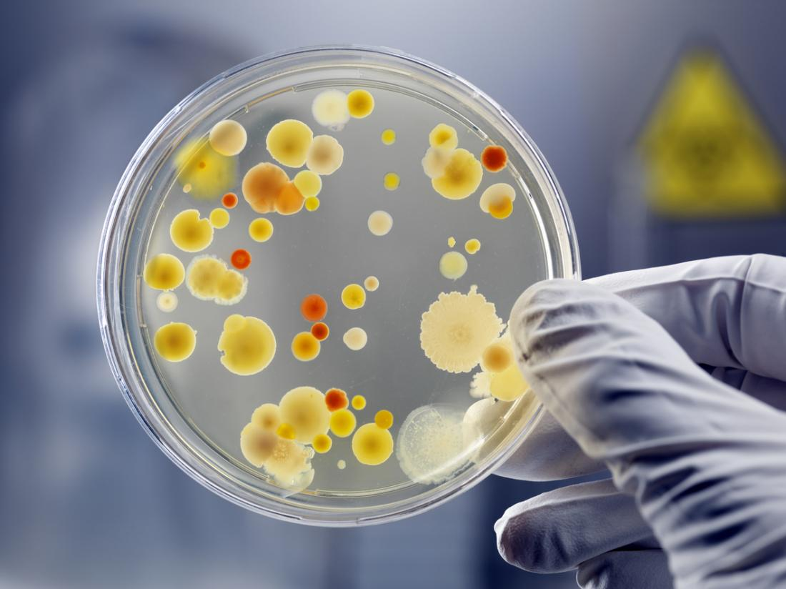
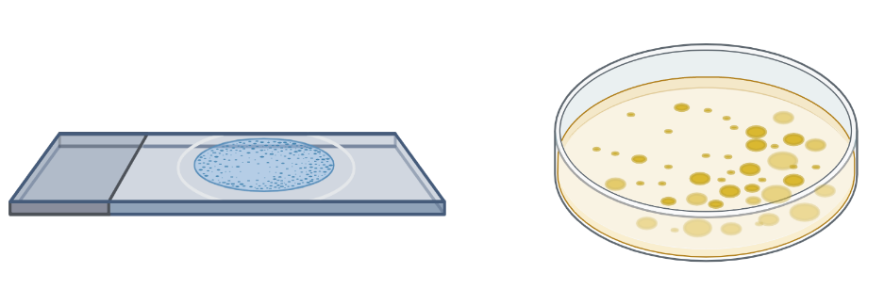
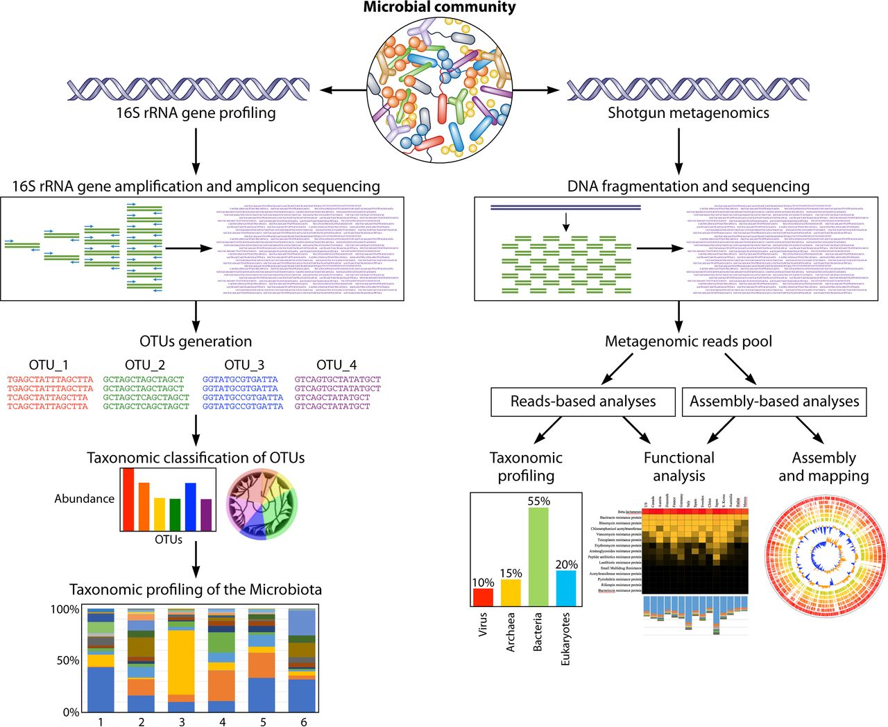
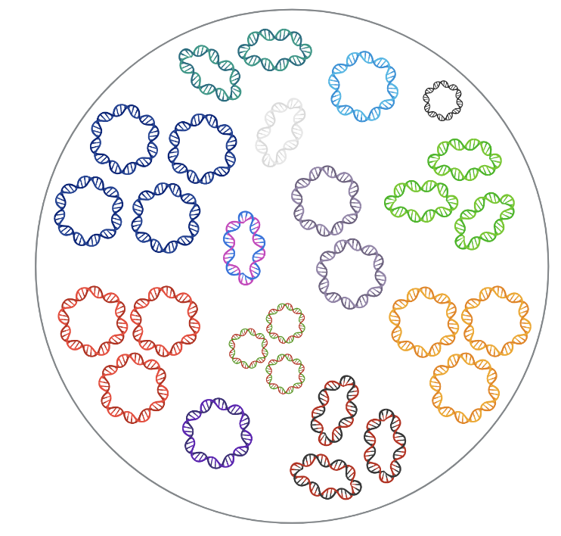
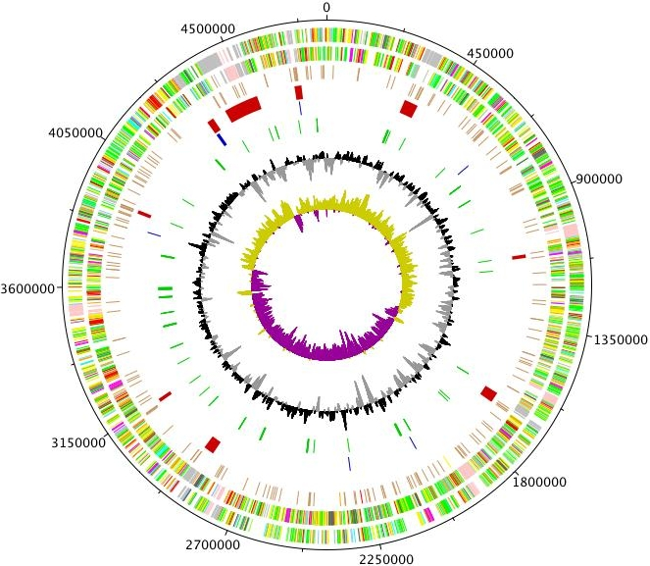
2
How well the isolated strains represent the kefir community?
Genomes from isolates
ASVs from metagenomes
Species a
ASV2
Species b
ASV1
ASV3
ASV5
Species c
ASV4
ASV6
Species d
ASV7
Culture-dependent
Culture-independent
Isolate DNA
16S rRNA amplicon sequences
Lentilactobacillus
Liquiorilactobacillus
Lacticaseibacillus

Slide 3
3
How well the isolated strains represent the kefir community?
Species
14 bacteria + 1 yeast
ESL0961 - Lacticaseibacillus paracasei
ESL0965 - Lacticaseibacillus paracasei
ESL0967 - Lacticaseibacillus paracasei
ESL0969 - Lacticaseibacillus paracasei
ESL0962 - Lentilactobacillus parabuchneri
ESL0970 - Lentilactobacillus parabuchneri
ESL0976 - Lentilactobacillus hilgardii
ESL0964 - Liquorilactobacillus nagelii
ESL0966 - Liquorilactobacillus nagelii
ESL0968 - Liquorilactobacillus nagelii
ESL0971 - Liquorilactobacillus nagelii
ESL0972 - Liquorilactobacillus nagelii
ESL0974 - Liquorilactobacillus nagelii
ESL0963 - Liquorilactobacillus ghanensis
ESL0975 - Brettanomyces bruxellensis
How many?
ASVs
ASV1
ASV2
ASV3
ASV4
ASV5
ASV6
ASV7
ASV7
ASV8
ASV9
ASV10
ASV11
.
.
.
ASVn
ASVs from metagenomes
Genomes from isolates
?¿
Species a
1
Genus 1
ASV2
Species b
ASV1
2
ASV3
Genus 2
ASV5
Species c
3
ASV4
Species d
ASV6
ASV7
Culture-dependent
4
Genus 3
Culture-independent
16S rRNA amplicon sequences
5
Genus 4
6

Slide 4

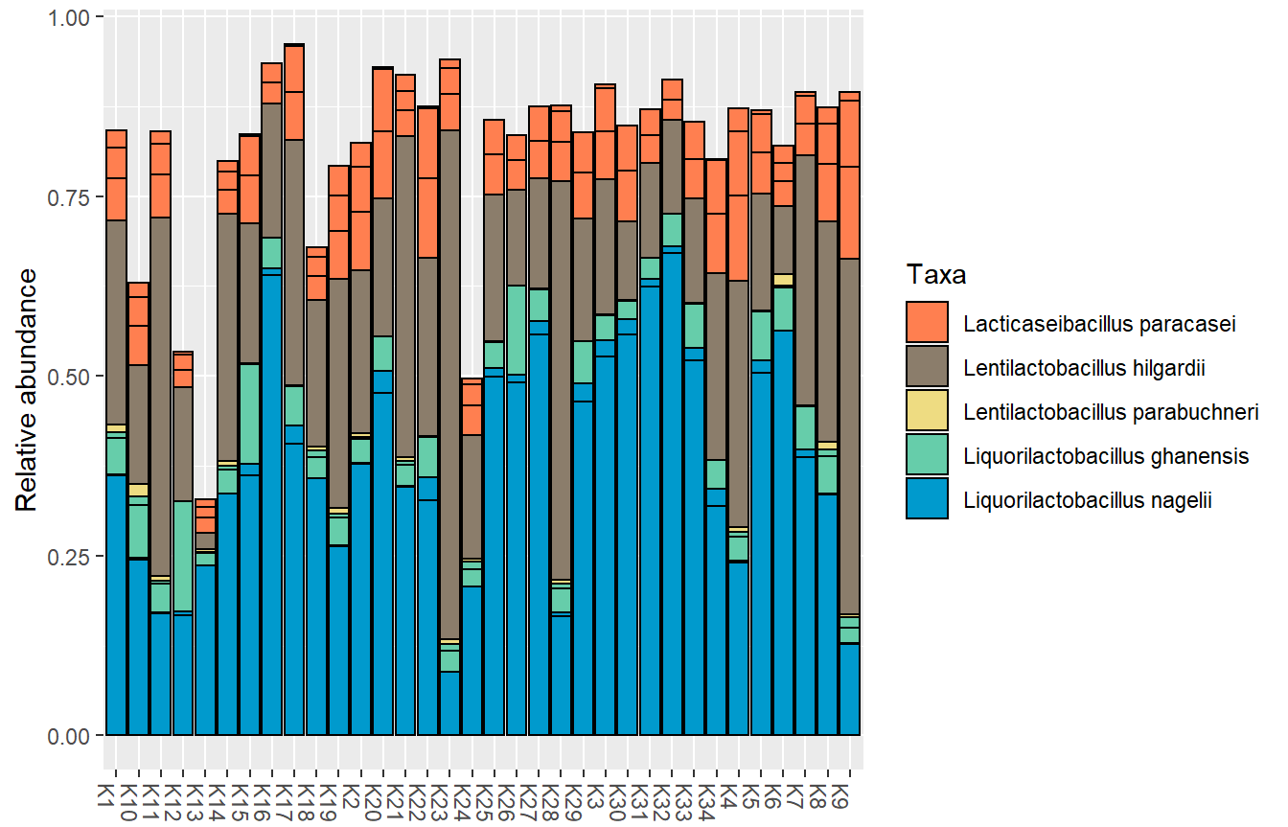
4
Species a
ASV2
Species b
Protocol…
ASV1
Extract 16S rRNA sequences in FASTA from the genomes of the isolates
Create BLAST database with ASV sequences.
Blast the 16S rRNA sequences from the isolates against the ASV database
Filter BLAST results
Plot results
ASV3
ASV5
Species c
ASV4
ASV6
Species d
phyloseq_ASVs.fasta
ASV7
2. BLAST database of ASV seq.
makeblastdb
1. Extract 16S rRNA genes
Isolates_16SrRNAs.fasta
3. BLAST
ASV_DB
blastn
barrnap
subject
curnalg
query
Lentilactobacillus
Liquiorilactobacillus
*this step has already been done for you
Blast_16SrRNAs_vs_ASVs_results.txt
Lacticaseibacillus
4. Filter BLAST results & plot
barney

Slide 5
5
Protocol…
Extract 16S rRNA sequences in FASTA from the genomes of the isolates
Create BLAST database with ASV sequences.
Blast the 16S rRNA sequences from the isolates against the ASV database
Filter BLAST results
Plot results
ssh <username>@curnagl.dcsr.unil.ch
curnalg
http://barney.unil.ch:8787/
barney

Slide 6
6
1. Genome 16S rRNA extraction - barrnap
Barrnap (BAsic Rapid Ribosomal RNA Predictor) predicts the location of ribosomal RNA genes in genomes. https://github.com/tseemann/barrnap
Lentilactobacillus
Liquiorilactobacillus
Lacticaseibacillus
16S rRNA genes
Species
15 bacteria + 1 yeast
ESL0961 - Lacticaseibacillus paracasei
ESL0965 - Lacticaseibacillus paracasei
ESL0967 - Lacticaseibacillus paracasei
ESL0969 - Lacticaseibacillus paracasei
ESL0962 - Lentilactobacillus parabuchneri
ESL0970 - Lentilactobacillus parabuchneri
ESL0968_iso_01 - Lentilactobacillus parabuchneri
ESL0976 - Lentilactobacillus hilgardii
ESL0964 - Liquorilactobacillus nagelii
ESL0966 - Liquorilactobacillus nagelii
ESL0968_iso_02 - Liquorilactobacillus nagelii
ESL0971 - Liquorilactobacillus nagelii
ESL0972 - Liquorilactobacillus nagelii
ESL0974 - Liquorilactobacillus nagelii
ESL0963 - Liquorilactobacillus ghanensis
ESL0975 - Brettanomyces bruxellensis
Command we used to extract rRNA sequences from the genomes:
--kingdom bac specifies the Bacteria specific database.
--outseq creates a FASTA file with the hit sequences
5
5
5
5
5
5
5
5
6
6
6
6
6
6
6
1
barrnap --kingdom bac <genommes/*.fna> \
--outseq <Isolates_rRNAs.fasta>
Genus 1
2
Genus 2
The results include 16S rRNA as well as 5S rRNA and 23S rRNA.
We filtered out the 5S and 23S
3
Genus 3
4
Total of 82 16S rRNA genes identified
5
Saved on curnalg: /scratch/jgianott/SAGE/SAGE2022_2023/common_files/ASV_matching/Isolates_16SrRNAs.fasta
Genus 4
6

Slide 7
7
2. Create BLAST database with ASV sequences
Load required BLAST modules:
How many?
ASVs
ASV1
ASV2
ASV3
ASV4
ASV5
ASV6
ASV7
ASV7
ASV8
ASV9
ASV10
ASV11
.
.
.
ASVn
ASVs from metagenome
module load gcc/10.4.0
module load blast-plus/2.12.0
Species a
Create database with the ASVs sequences
ASV2
Species b
ASV1
makeblastdb –in <04_Phyloseq_object/phyloseq_ASVs.fasta> \
--dbtype nucl \
-out ASVs_DB
ASV3
ASV5
Species c
ASV4
ASV6
Species d
ASV7
Culture-independent
16S rRNA amplicon sequences
*Note: Do not copy and paste code from here! Use the Tutorial .html file provided!

Slide 8
8
3. BLAST 16S rRNA sequences from the isolates against the ASV database
Load required BLAST modules:
Species
module load gcc/10.4.0
module load blast-plus/2.12.0
16S rRNA
ESL0961
ESL0965
ESL0967
ESL0969
ESL0962
ESL0970
ESL0976
ESL0964
ESL0966
ESL0968
ESL0971
ESL0972
ESL0974
ESL0963
How many ASVs?
ASV1
ASV2
ASV3
ASV4
ASV5
ASV6
ASV7
ASV7
ASV8
ASV9
ASV10
ASV11
.
.
.
ASVn
?¿
1
Genus 1
Create database with the ASVs sequences
makeblastdb –in <04_Phyloseq_object/phyloseq_ASVs.fasta> \
--dbtype nucl \
-out ASVs_DB
2
Genus 2
3
Blast 16S rRNA isolate sequences against ASV DB
blastn –query <Isolates_16SrRNAs.fasta> \
-task megablast \
-db <ASVs_DB> \
-out <Blast_16SrRNAs_vs_ASVs_results.txt> \
-outfmt ‘7 std qcovs’ \
-perc_identity 95
4
Genus 3
5
*Note: Do not copy and paste code from here! Use the Tutorial .html file provided!

Slide 9
9
To summarize, create a script with the following required commands
Load required modules:
1
#!/bin/bash
######### SLURM OPTIONS
#SBATCH --job-name ASVmatching
#SBATCH --account jgianott_sage
#SBATCH --nodes 1
#SBATCH --ntasks 1
#SBATCH --cpus-per-task 8
#SBATCH --mem 8G
#SBATCH --time 1:00:00
#SBATCH --error /user/<username>/sage22/<username>/logs/ASVmatch.err
#SBATCH --output /user/<username>/sage22/<username>/logs/ASVmatch.out
### Loading the modules ###
2
module load gcc/10.4.0
module load blast-plus/2.12.0
Create variables and directory to store results
3
scratch=/scratch/jgianott/SAGE/SAGE2022_2023
username=<username>
phylo_ASVs=<path_to/phyloseq_ASVs.fasta>
mkdir ${scratch}/${username}/ASV-isolate_match
asv_dir= ${scratch}/${username}/ASV-isolate_match
cp ${scratch}/common_files/ASV_matching/Isolates_16SrRNAs.fasta
${asv_dir}/Isolates_16SrRNAs.fasta
4
Execute makeblastdb and blastn
Locate this file generated during the DADA2 tutorial in Barney
Download it into your computer
Upload it to Curnalg using scp!
Specify full path here!
makeblastdb –in ${phylo_ASVs} \
-dbtype nucl \
-out ${asv_dir}/ASVs_DB
blastn –query ${asv_dir}/Isolates_16SrRNAs.fasta \
-task megablast \
-db ${asv_dir}/ASVs_DB \
-out ${asv_dir}/Blast_16SrRNAs_vs_ASVs_results.txt \
-outfmt ‘7 std qcovs’ \
-perc_identity 95
*Note: Do not copy and paste code from here! Use the Tutorial .html file provided!

Slide 10

ASV-isolate matching
Tutorial
28032023_TutorialASV-isolate_matching.html

Slide 11
11
4. BLAST results
blastn –query <Isolates_16SrRNAs.fasta> \
-task megablast \
-db <ASVs_DB> \
-out <Blast_16SrRNAs_vs_ASVs_results.txt> \
-outfmt ‘7 std qcovs’\
-perc_identity 95
The supported format specifiers for options 6, 7 and 10 are:
...
qaccver means Query accesion.version
saccver means Subject accession.version
qstart means Start of alignment in query
qend means End of alignment in query
sstart means Start of alignment in subject
send means End of alignment in subject
evalue means Expect value
bitscore means Bit score
length means Alignment length
pident means Percentage of identical matches
mismatch means Number of mismatches
gapopen means Number of gap openings
...
qcovs means Query Coverage Per Subject
...
When not provided, the default value is:
'qaccver saccver pident length mismatch gapopen qstart qend
sstart send evalue bitscore', which is equivalent to the
keyword 'std'
[dgarrido@curnagl ~]$ blastn –help
*** Formatting options
-outfmt <String>
alignment view options:
0 = Pairwise,
1 = Query-anchored showing identities,
2 = Query-anchored no identities,
3 = Flat query-anchored showing identities,
4 = Flat query-anchored no identities,
5 = BLAST XML,
6 = Tabular,
7 = Tabular with comment lines,
8 = Seqalign (Text ASN.1),
9 = Seqalign (Binary ASN.1),
10 = Comma-separated values,
11 = BLAST archive (ASN.1),
12 = Seqalign (JSON),
13 = Multiple-file BLAST JSON,
14 = Multiple-file BLAST XML2,
15 = Single-file BLAST JSON,
16 = Single-file BLAST XML2,
17 = Sequence Alignment/Map (SAM),
18 = Organism Report
*** Restrict search or results
...
-perc_identity <Real, 0..100>
Percent identity

Slide 12
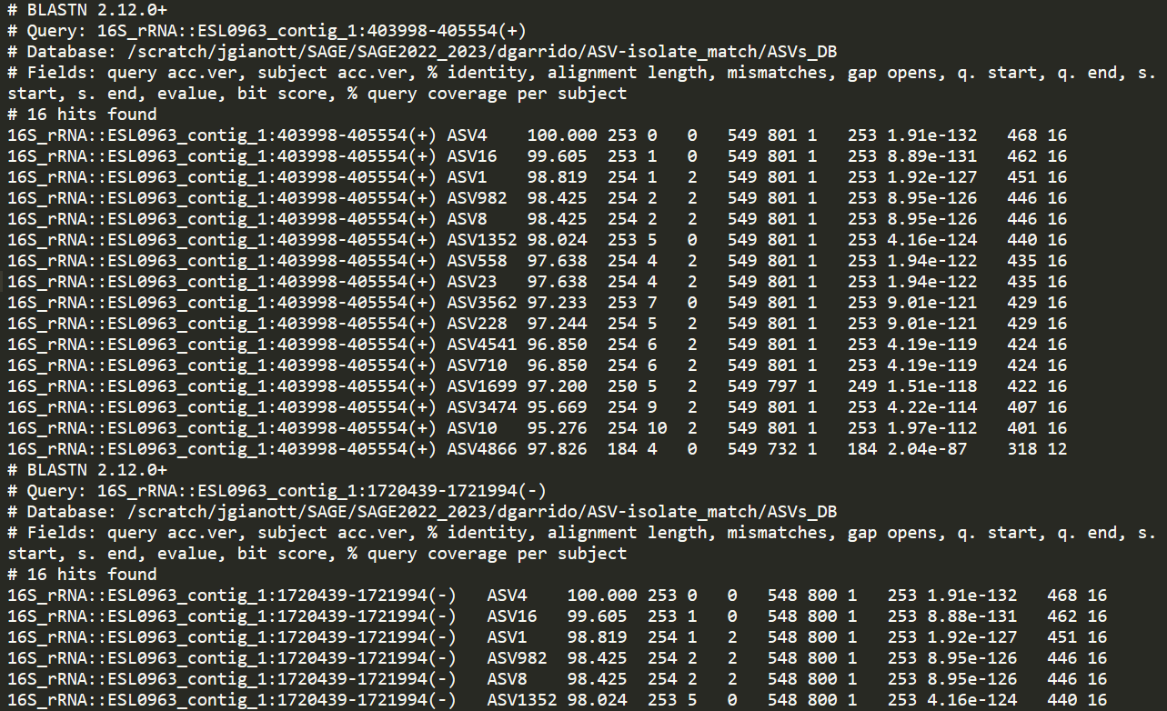
12
4. BLAST results
Blast_16SrRNAs_vs_ASVs_results.txt
#Info | blast v.
query
db
fields
hits no.
Hits |
*we put a min %ident of 95%
Results for the second query seq.
… …
x82

Slide 13
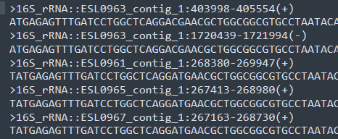
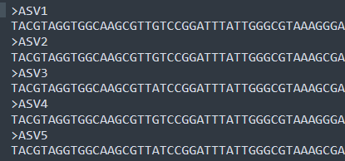
13
4. BLAST results
Blast_16SrRNAs_vs_ASVs_results.txt
#Info | blast v.
query
db
fields
hits no.
Isolates_16SrRNAs.fasta – query sequences
Phyloseq_ASVs.fasta – subject sequences (in ASV_DB)
Header1
Hits |
*we put a min %ident of 95%
Sequence1
Header2
Sequence2
Header3
Sequence3
Results for the second query seq.
… …
x82

Slide 14
14
4. BLAST results
Blast_16SrRNAs_vs_ASVs_results.txt
#Info | blast v.
query
db
fields
hits no.
Hits |
*we put a min %ident of 95%
Results for the second query seq.
… …
x82

Slide 15
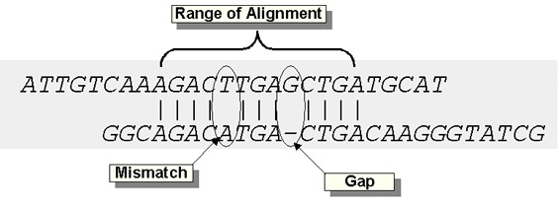
15
4. BLAST results
Blast_16SrRNAs_vs_ASVs_results.txt
%query cov.
Query acc. ver
Subject acc. ver
Alignment len
Subject end
Bit score
% identity
Mismatches
Query start
Gaps
Query end
Subject start
E-value

Slide 16
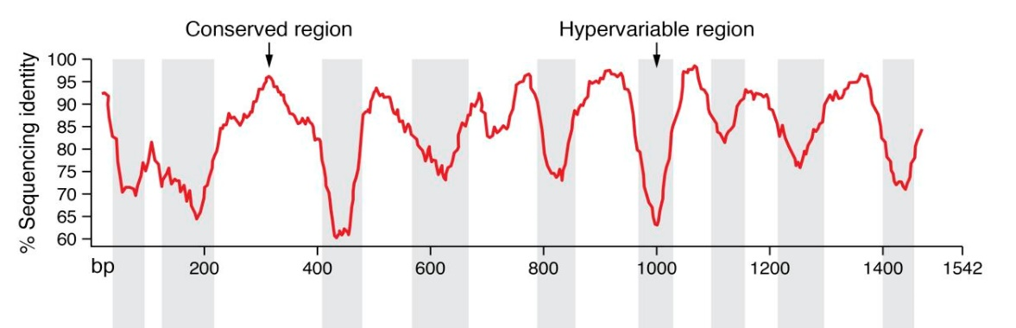
16
4. BLAST results
Blast_16SrRNAs_vs_ASVs_results.txt
V1 V2 V3 V4 V5 V6 V7 V8 V9
515F
806R
V4, insert size of 300 bp
%query cov.
Query acc. ver
Subject acc. ver
Alignment len
Subject end
Bit score
% identity
Mismatches
Query start
Gaps
Query end
Subject start
E-value

Slide 17
17
4. BLAST results - filter
Blast_16SrRNAs_vs_ASVs_results.txt

Slide 18
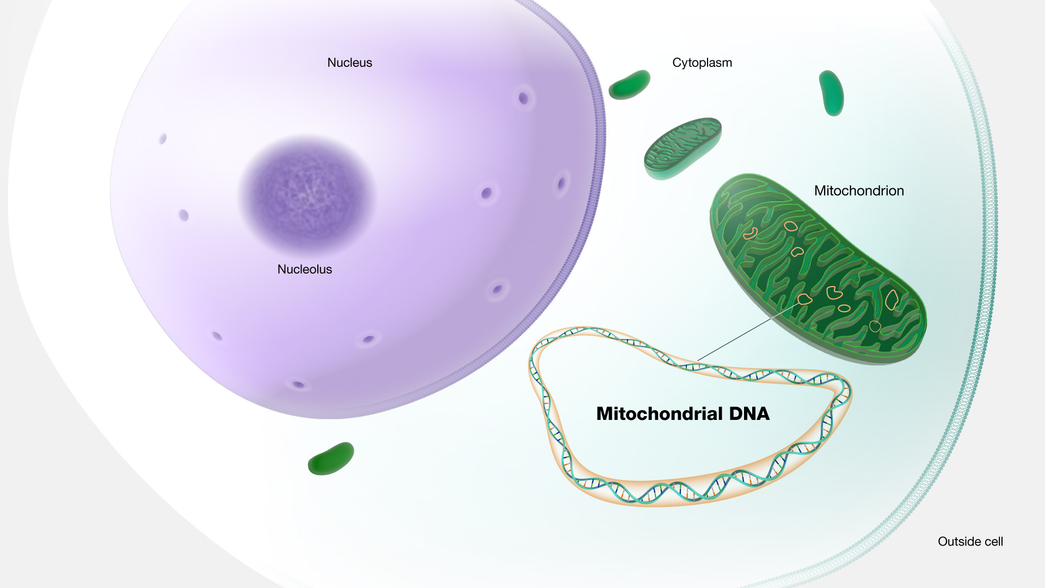
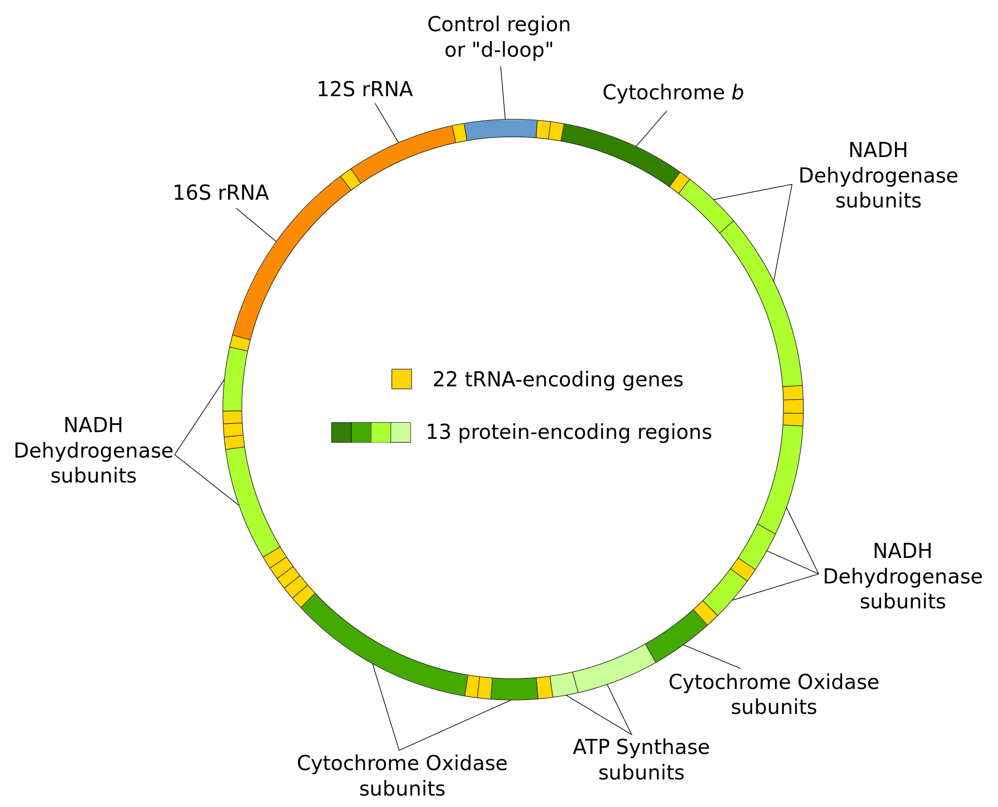
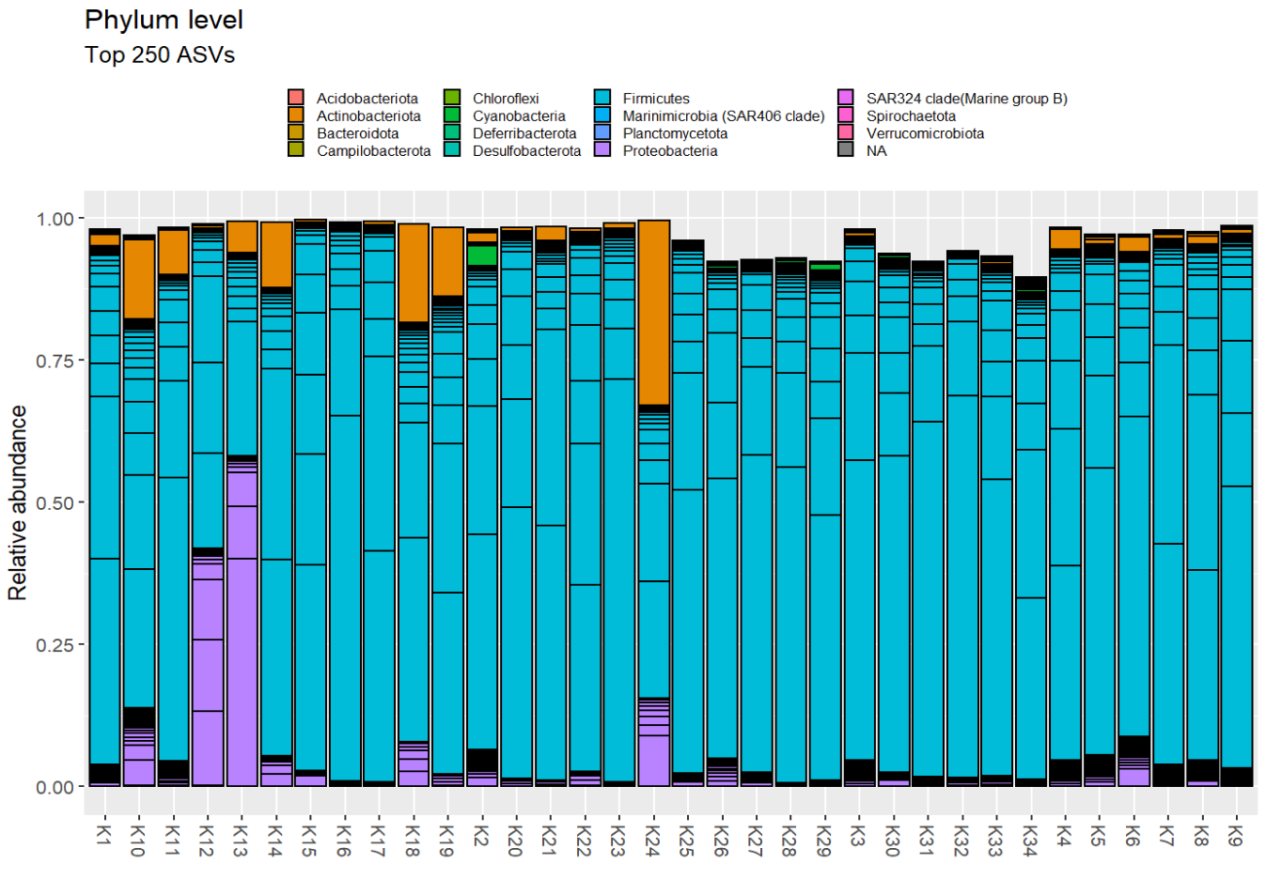
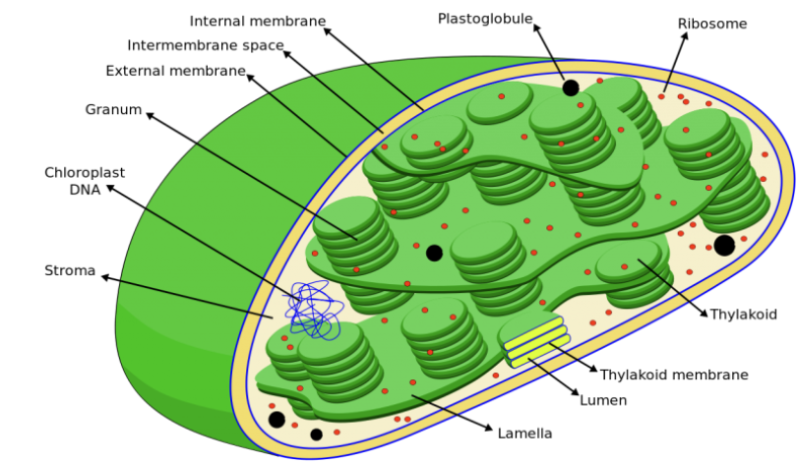
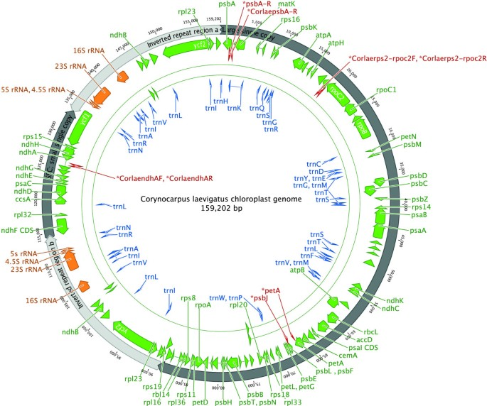
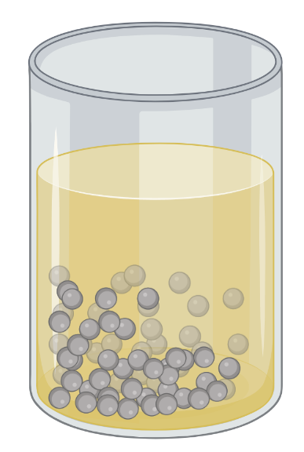
18
Results
Previous Kefir granules
Water
Sugar
Lemon slice
Dried figs / Raisins

Slide 19
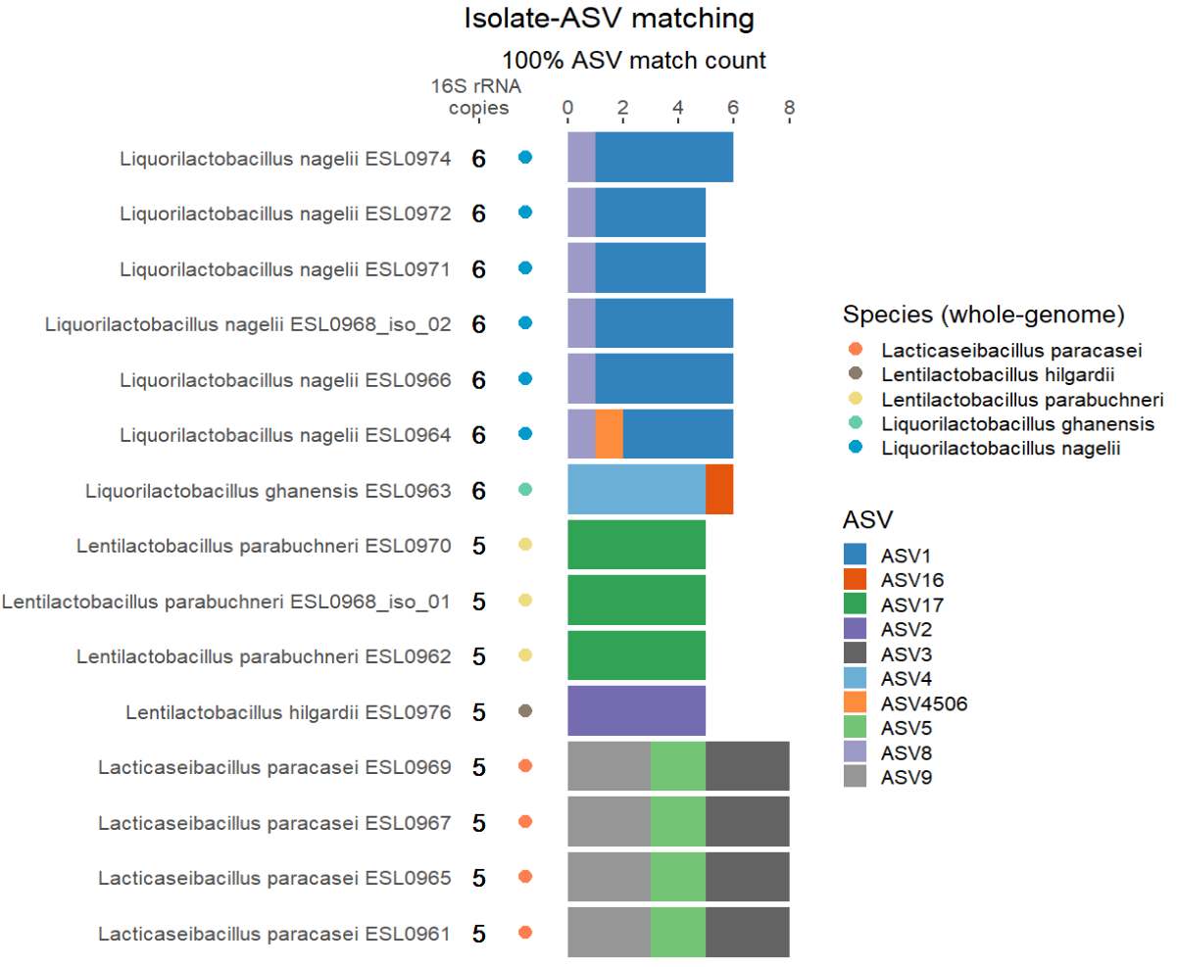
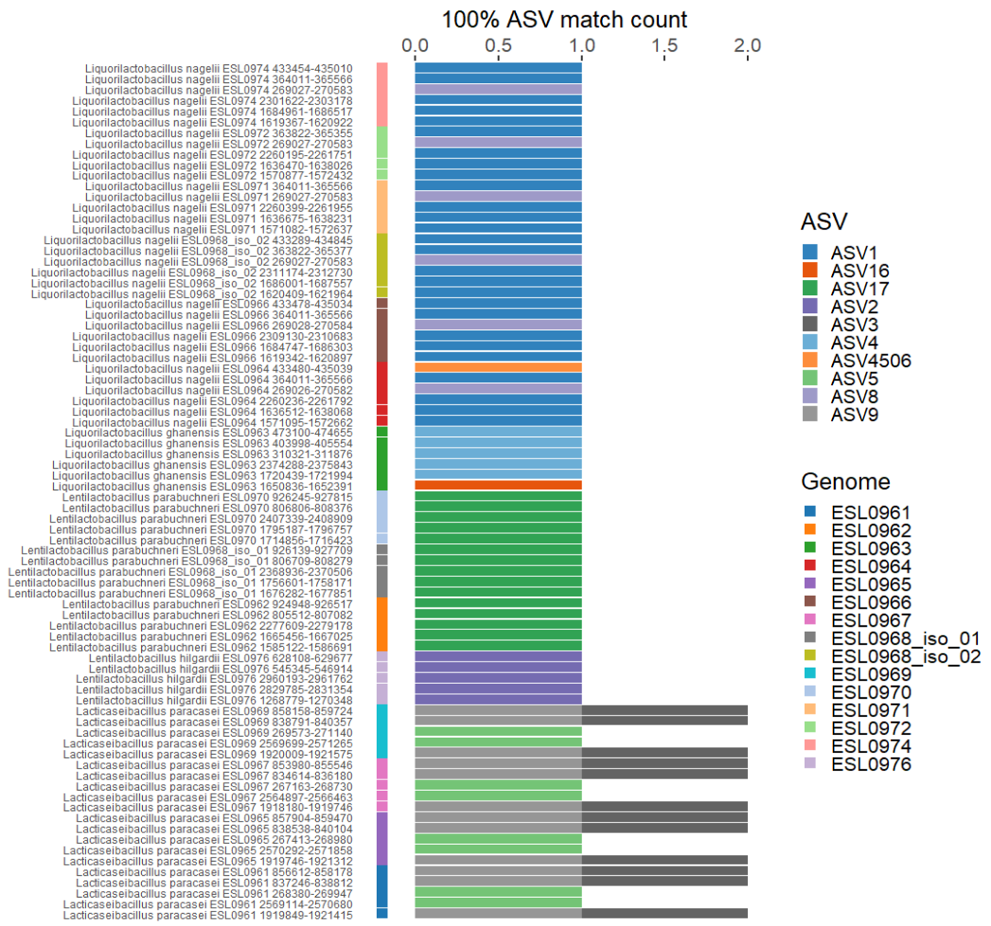
19
Results
Number and identity of ASVs matching each genome
Q: Why most isolates have multiple ASVs matching?
Q: How can you explain that L. paracasei genomes match 8 ASVs while
these genomes only contain 5 copies of the 16S rRNA gene?
and others like L. nagelii that have 6 copies of the 16S rRNA match
with less? (hint, check the unfiltered Blast results)
Number and identity of ASVs matching each 16S rRNA gene copy

Slide 20
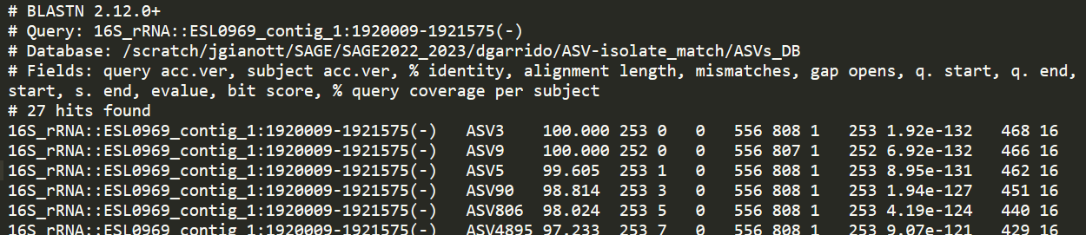
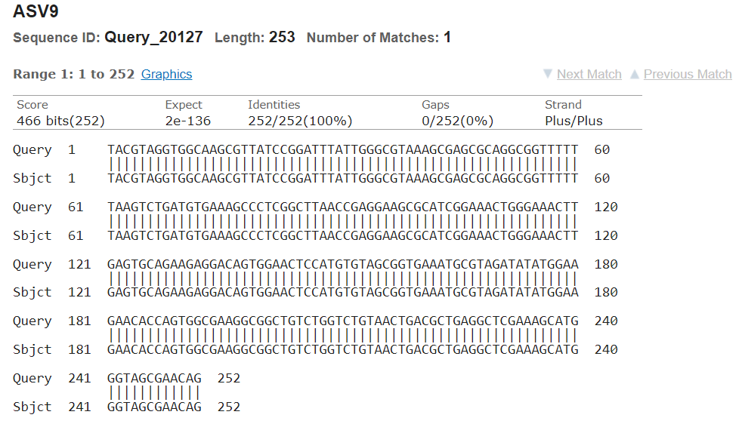
20
Results
Number and identity of ASVs matching each genome
Q: Why most isolates have multiple ASVs matching?
Q: How can you explain that L. paracasei genomes match 8 ASVs while
these genomes only contain 5 copies of the 16S rRNA gene?
and others like L. nagelii that have 6 copies of the 16S rRNA match
with less? (hint, check the unfiltered Blast results)
Number and identity of ASVs matching each 16S rRNA gene copy

Slide 21
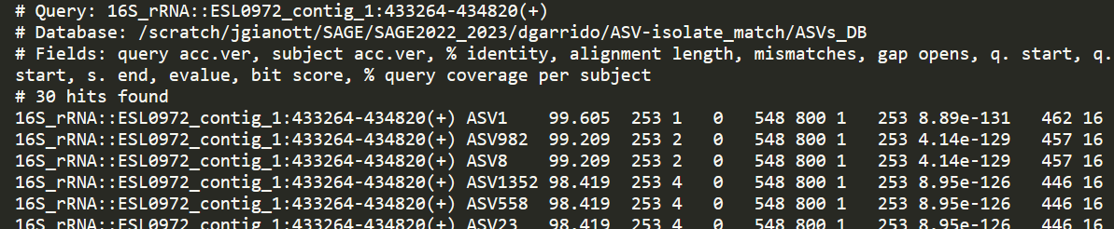
21
Results
Number and identity of ASVs matching each genome
Q: Why most isolates have multiple ASVs matching?
Q: How can you explain that L. paracasei genomes match 8 ASVs while
these genomes only contain 5 copies of the 16S rRNA gene?
and others like L. nagelii that have 6 copies of the 16S rRNA match
with less? (hint, check the unfiltered Blast results)
Number and identity of ASVs matching each 16S rRNA gene copy

Slide 22
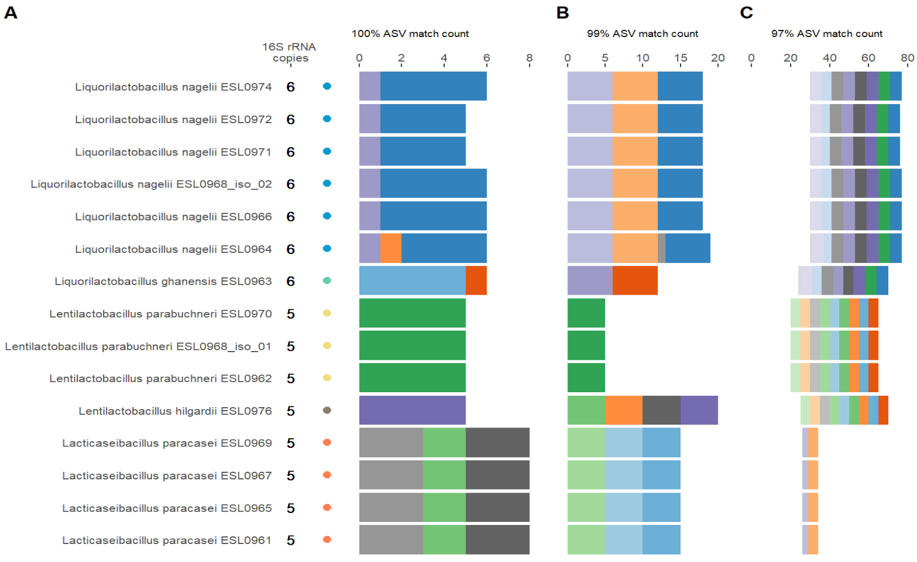
22
Results
100% ASV match count
99% ASV match count
97% ASV match count
Filt. Threshold | Unique ASVs. no.
100% | 10
99% | 14
97% | 34
95% | 77

Slide 23
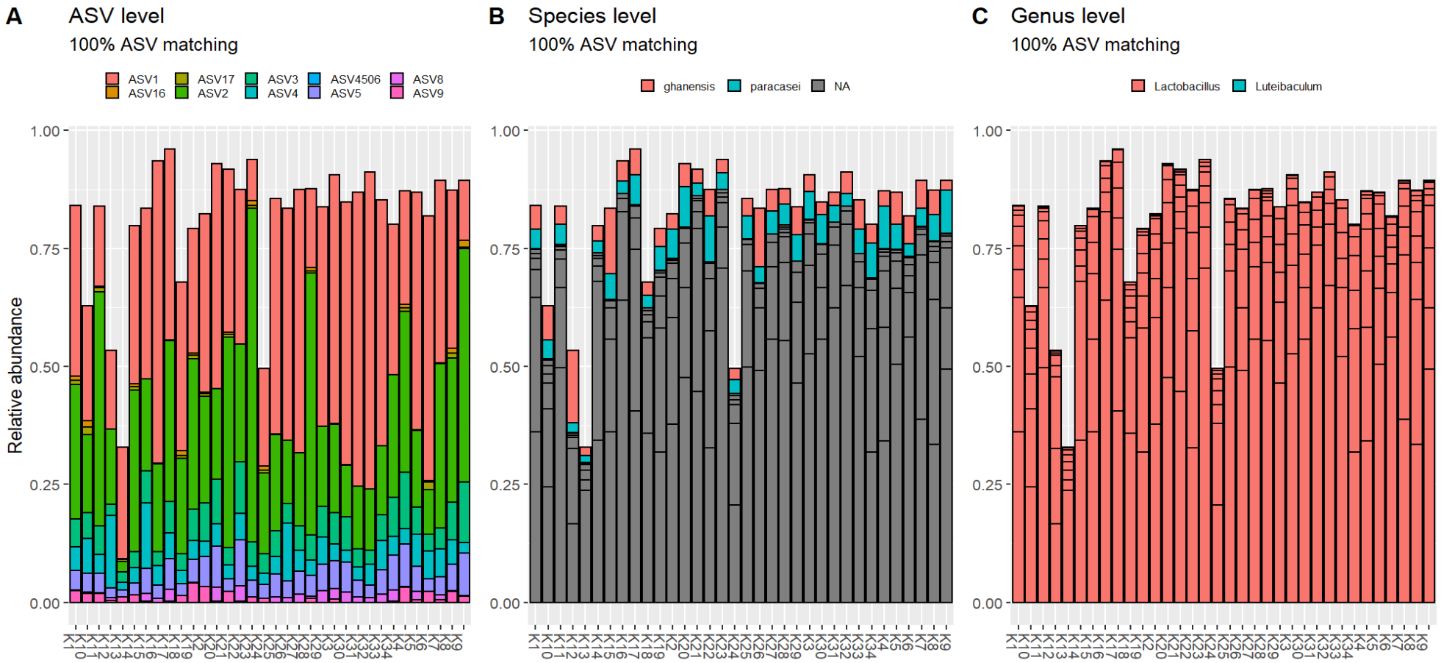
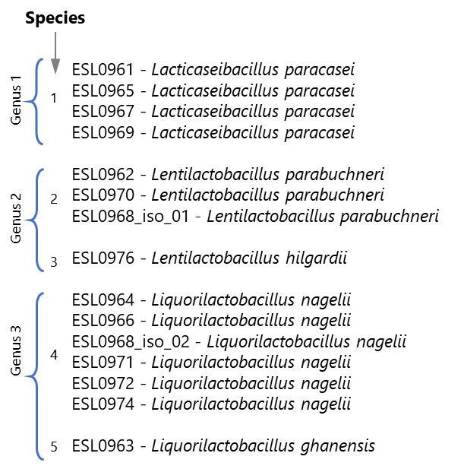
23
Results
Q: Do the strains that we isolated and sequenced during SAGE I represent a big part of the community?
Q: How many of the matching ASVs are classified at the Species level? Do you observe the 5 different species identified in the collection of assembled genomes?
Q: Check also the classification of the matching ASVs at the Genus level. What do you see? Do you see the 3 different genera identified in the collection of the assembled genomes?
Q: How can you explain the differences observed in the taxonomy of ASVs at the genus and species levels compared with the taxonomy of the assembled genomes?

Slide 24
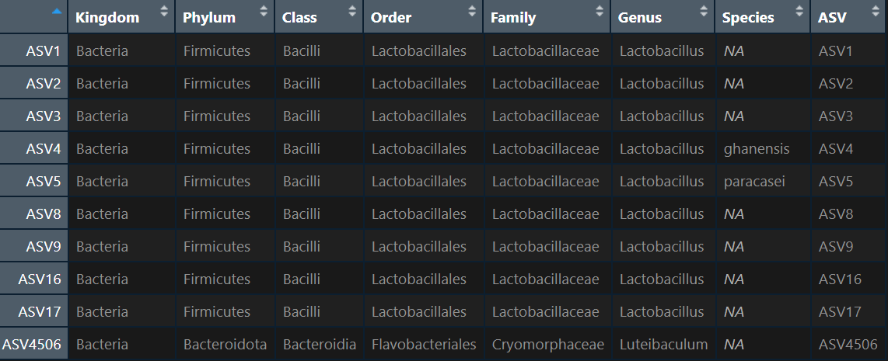
24
Results
ASVs classification based on SILVA database.
(almost)All ASVs assigned to the same Genus.
Only two species identified
“Lactobacillus” ghanensis reclassified as Liquorilactobacillus ghanensis by Zheng et al. 2020
“Lactobacillus” paracasei reclassified as Lacticaseibacillus paracaseii by Zheng et al. 2020

Slide 25
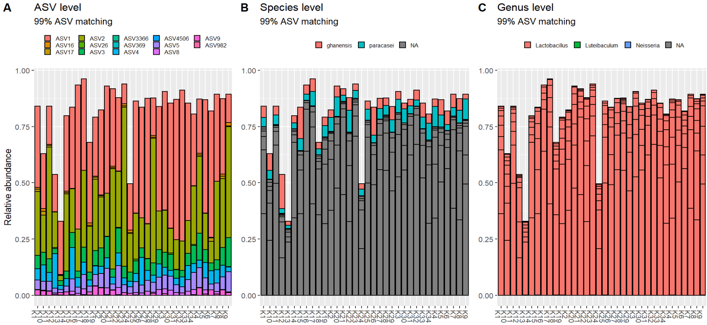
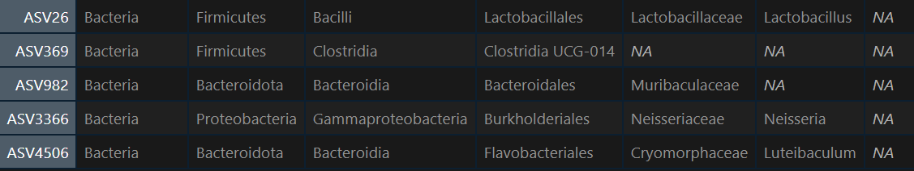
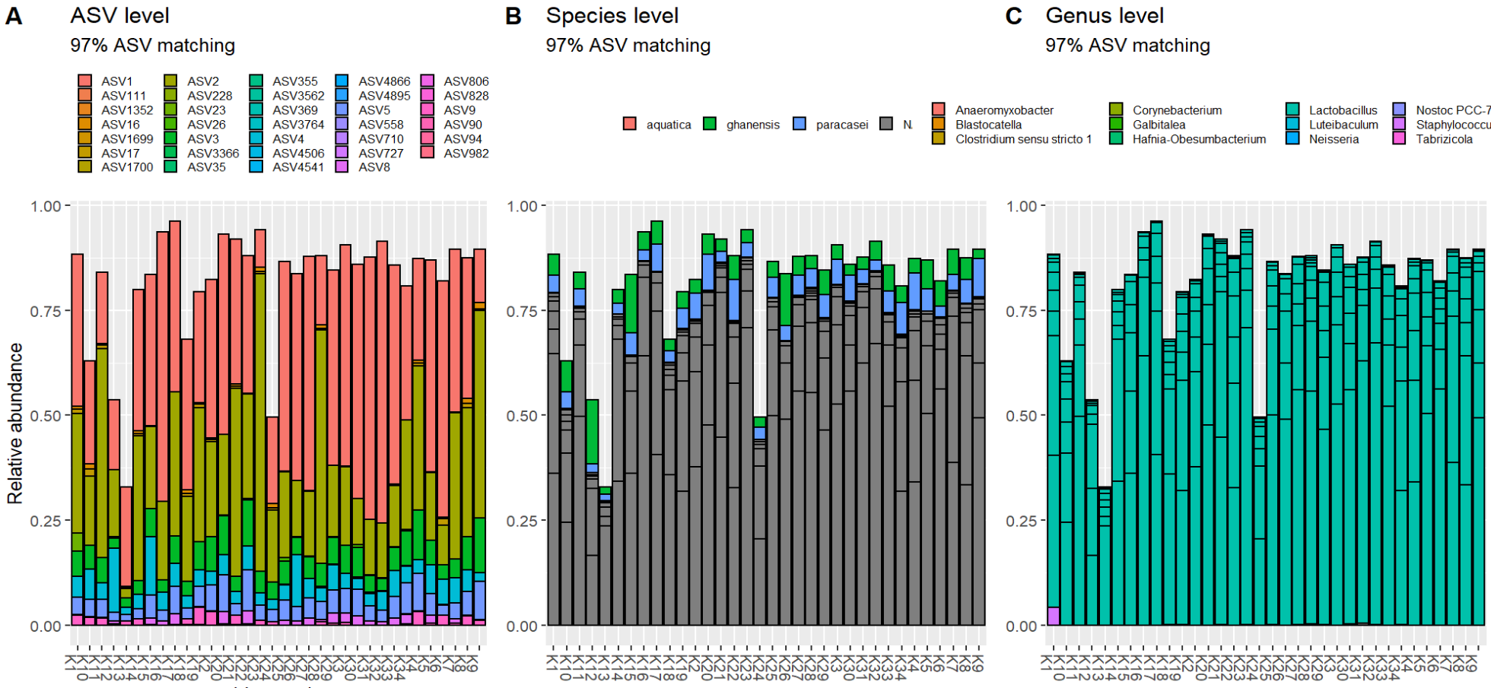
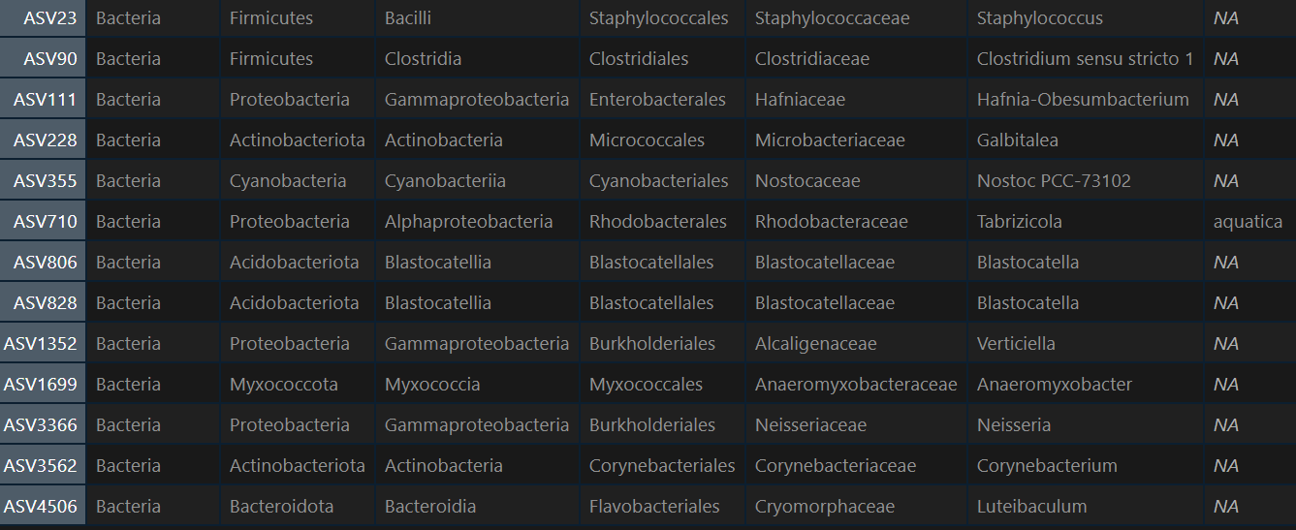
25
Results
100%
99%
97%

Slide 26
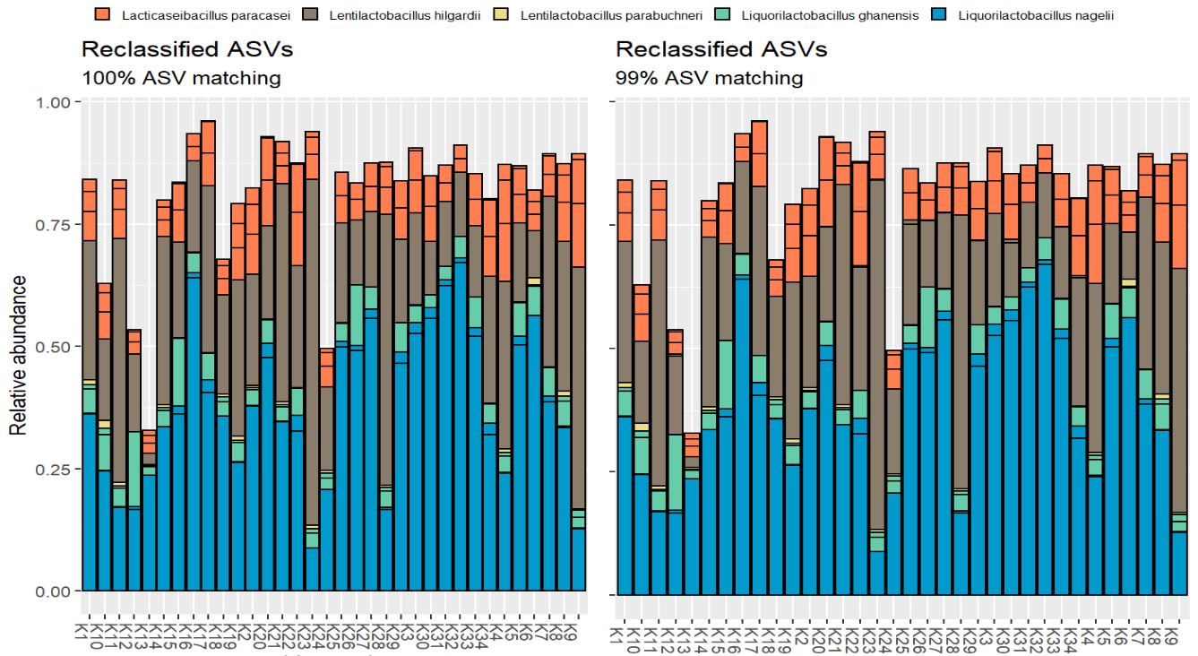
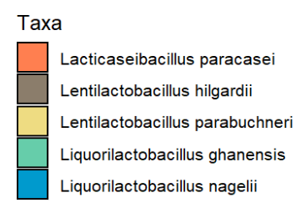
26
Results

Slide 27
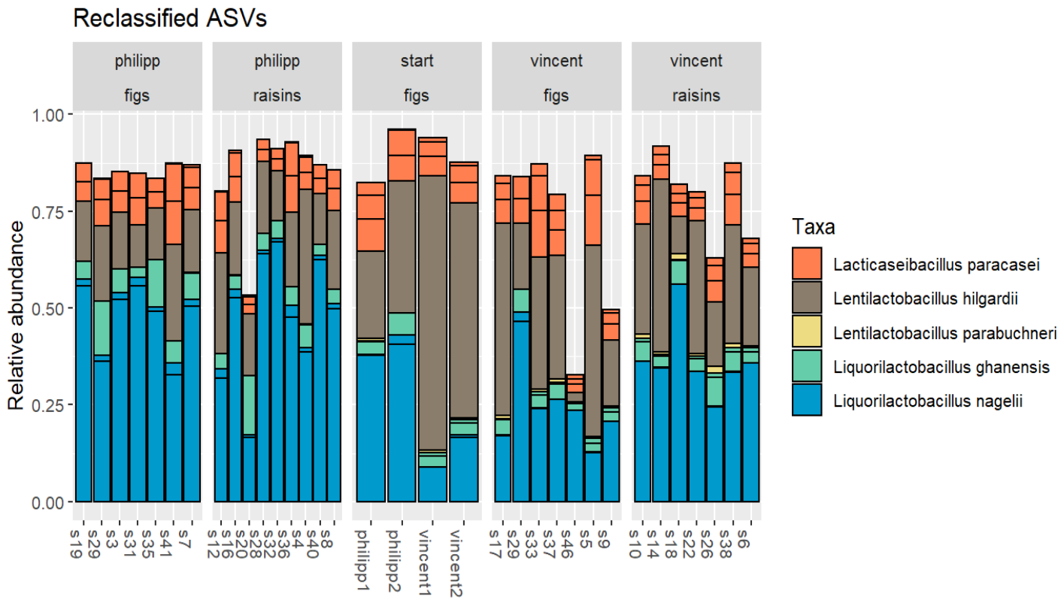
27
```{r}
ggplot(…) +
… +
facet_wrap(~inoculum+fruit …)
```
Results

Slide 29
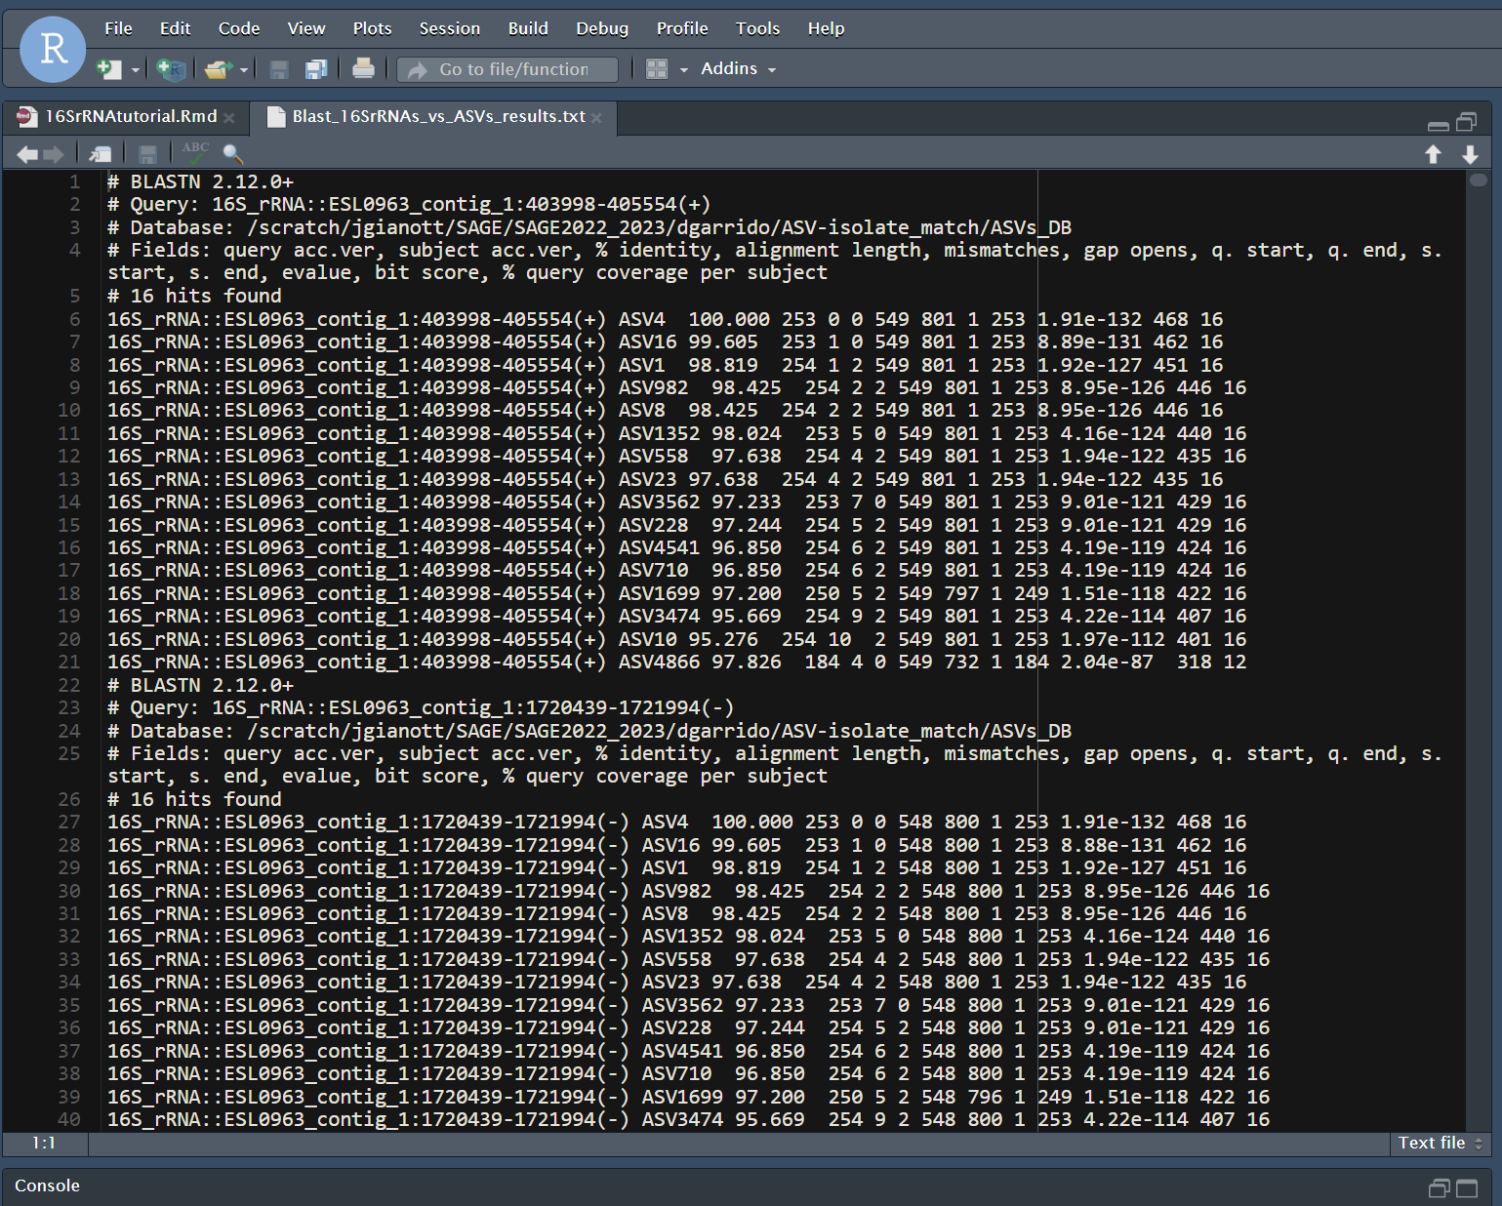
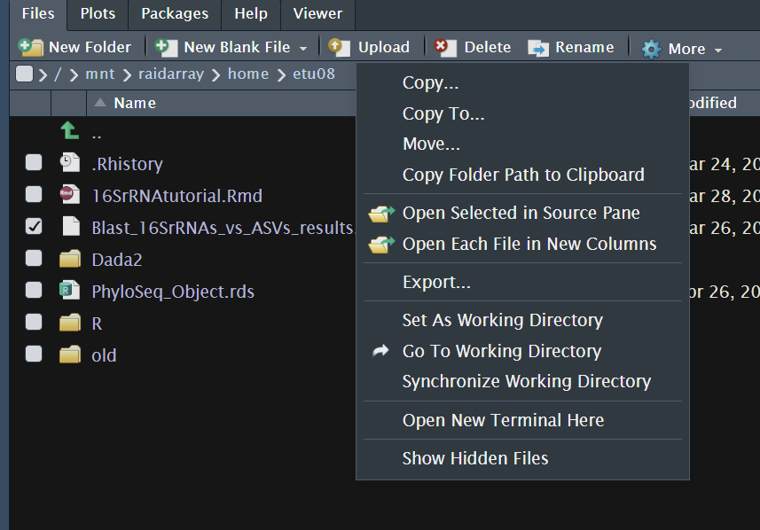
29
If curnalg still down…
Copy of BLAST results saved on Barney server
/mnt/raidarray/home/etu08/Blast_16SrRNAs_vs_ASVs_results.txt

